Slide 1
Decode this Message
TWLSUEN
HODSA?O
ERIQR!!
Write a code that will decode this message

Slide 2
Reading and Writing to A File

Slide 3
Possibilities of Error
File is not there
We don’t have permission to go there
There is a problem with getting information

Slide 4
Try -Catch
Tries to do one thing, and in case of an error, does something else
try {
<Something> }
catch(<Some error>) {
}

Slide 5
catch (IOException e)
Catches any errors with opening/reading/writing/closing a file
For now, aside from saying it doesn’t work, don’t worry too much

Slide 6
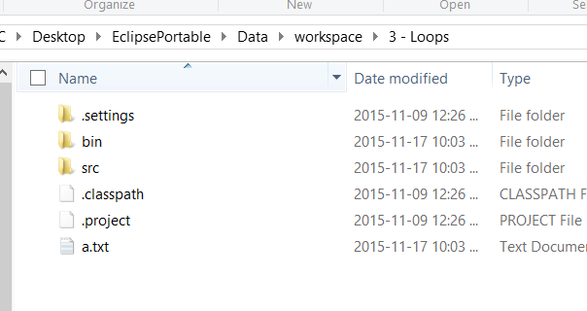
Reading from a File
Reads from the project folder
Ie. my project is called 3 – Loops

Slide 7
3 Things You Need
File – a file
FileReader – an object that takes your file and reads it
BufferedReader – an object that takes your file information and makes it useable

Slide 8
Format
File myFile = new File(“the filename/address as a string”);
try {
FileReader fr = new FileReader(myFile);
BufferedReader reader = new BufferedReader(fr);
while ((line= reader.readLine()) != null) { //important!!!
Read the lines
}
reader.close();
fr.close();
} catch (IOException e) {
System.out.println(“Does not work”);
}

Slide 9
Using the Text
like the scanner, we can get things
If my BufferedReader were named reader, I could:
reader.read() – reads a single character and gives a character to be used
reader.readLine() – reads an entire line and gives a string to be used

Slide 10
Problem 1
Read from 1.txt. Print out the first letter of each line, then second, then third etc. until the end.
Ie. TIICO HSSOL -> THISISCOOL

Slide 11
3 Things You Need
File – a file
FileWriter – an object that takes your file and readies it for writing
BufferedWriter – an object that takes your data and makes it able to be written in a file

Slide 12
Writing Functions
like the System.out we can put things
If my BufferedWriter were named writer, I could:
writer.write() – takes a string and writes it to the file
writer.newLine() – creates a new line in the file

Slide 13
Problem 2
Ask the user for a text to write. Store their message into 4 lines, as if writing a coded message for the previous problem.
Store the solution in 2.txt
To see if you got it correct, use your previous problem to check if you get the same answer
Hint: try to make your message divisible by 4. If it cannot, add some letters until it is.

Slide 14
Problem 3
Read a file, and output what the most frequent word is
Initially, assume there are at most 100 different kinds of words

